Slide 1

6th Grade Accelerated Math
Unit 15, Lesson 2 Determining Sample Space Volume 2, pg. 406

Slide 2


Benchmark
MA.7.DP.2.1
Determine the sample space for a simple experiment.
volume 2, pg. 406

Slide 3
Integrated Mathematical Thinking and Reasoning Standards
MA.K12.MTR.4.1 Engage in discussions that reflect on the mathematical thinking of self and others.
MA.K12.MTR.7.1 Apply mathematics to real-world contexts.
volume 2, pg. 406

Slide 4

Learning Target
I can determine the sample space for a simple experiment.
volume 2, pg. 406

Slide 5

Warm-Up
volume 2, pg. 406

Slide 6
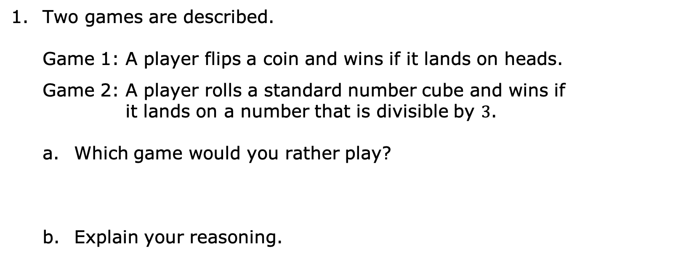
15.2.1 Warm-Up: Which Game Would You Choose?
Two games are described.
Game 1: A player flips a coin and wins if it lands on heads.
Game 2: A player rolls a standard number cube and wins if
it lands on a number that is divisible by $3$.
Which game would you rather play?
Explain your reasoning.
volume 2, pg. 406

Slide 7

Exploration
volume 2, pg. 407

Slide 8


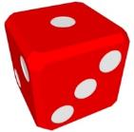
15.2.2 Exploration: Simple Experiments
Work with your partner to complete the following.
Discuss the sample space for both games from the Warm-Up with your partner.
Write the sample space for each in the table.
Random Process | Sample Space
Flipping a Coin
Rolling a Standard Number Cube
volume 2, pg. 407

Slide 9
What are the possible outcomes in the event of landing on heads in Game 1 from the Warm-Up?
What fraction of the possible outcomes from Game 1 results in a win?
volume 2, pg. 407

Slide 10
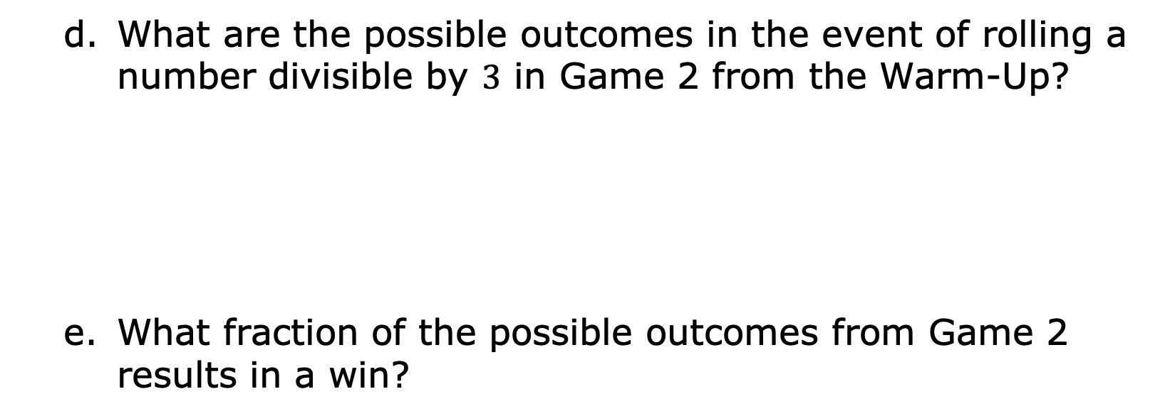
What are the possible outcomes in the event of rolling a number divisible by $3$ in Game 2 from the Warm-Up?
What fraction of the possible outcomes from Game 2 results in a win?
volume 2, pg. 407

Slide 11
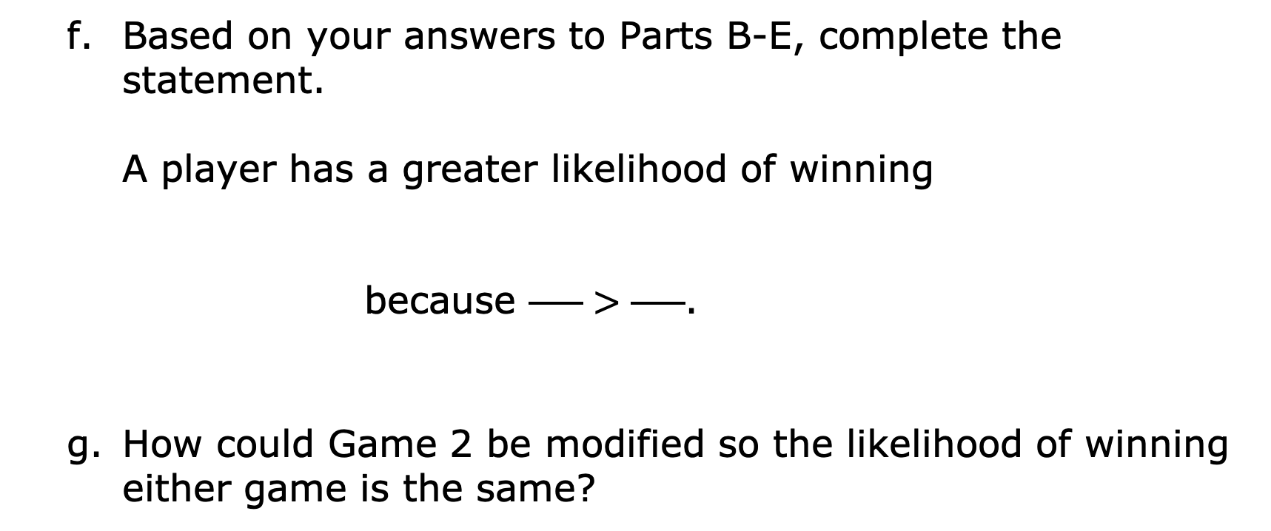
Based on your answers to Parts B-E, complete the statement. A player has a greater likelihood of winning because $\frac{ }{ }>\frac{ }{ }$.
How could Game 2 be modified so the likelihood of winning either game is the same?
Game 1
Game 2
volume 2, pg. 407

Slide 12
With your partner, determine who is partner A and who is partner B. For this activity, you and your partner will pull slips of paper from a bag.
Make a guess about what is on the slips of paper.
Without looking in the bag, partner A should take out one of the papers and show it to partner B. Both partners record what was printed on the paper in the first row of the table.
Who? | What is printed on the paper?
Partner A, Choice 1
Partner B, Choice 1
Partner A, Choice 2
Partner B, Choice 2
Partner A, Choice 3
Partner B, Choice 3
volume 2, pg. 408

Slide 13
Partner A should put the paper back into the bag. Then, partner B should take out one of the papers and show it to partner A for both to record in the table.
After both partners have made their first selection and put it back in the bag, make a revised guess of the sample space.
Continue taking turns and recording the results in the table until each partner has taken three turns.
Make a revised guess of the sample space.
volume 2, pg. 408

Slide 14
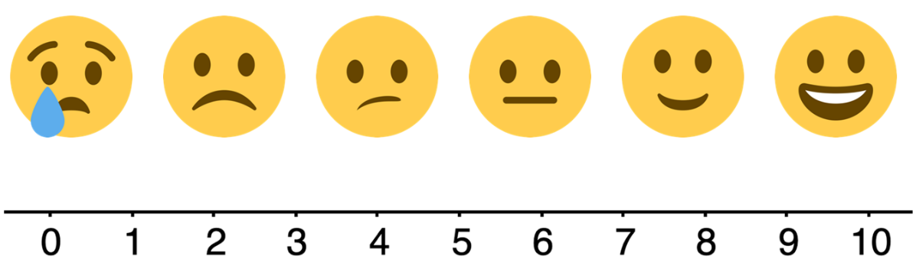
Rate your confidence in your last guess using the emoji scale.
Discuss with your partner what you could do to make a better guess of the sample space. Write at least two strategies you discussed.
Look at all the papers in the bag. Write the sample space.
volume 2, pg. 408

Slide 15

Bring It Together
volume 2, pg. 409

Slide 16

15.2.3 Bring It Together: Defining Simple Experiments
The games from the exploration are all considered simple experiments.
In a simple experiment, each outcome in the sample space is equally likely to happen; however, events, which are subsets of the sample space, may have different likelihoods of happening. This is called probability.
A simple experiment is an action that has a definite outcome that cannot be predicted with certainty.
The probability of an event is a measure of the likelihood the event will occur.
volume 2, pg. 409

Slide 17
Consider the simple experiment involving pulling papers from the bag in the Exploration.
Explain whether all of the possible outcomes in the sample space were equally likely or not.
Explain which of the following events would have been more likely to happen in that experiment – pulling out a paper with a vowel on it or pulling out a paper with a consonant on it.
volume 2, pg. 409

Slide 18

Guided Practice
volume 2, pg. 409

Slide 19

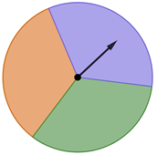
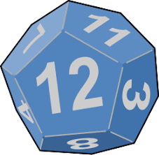
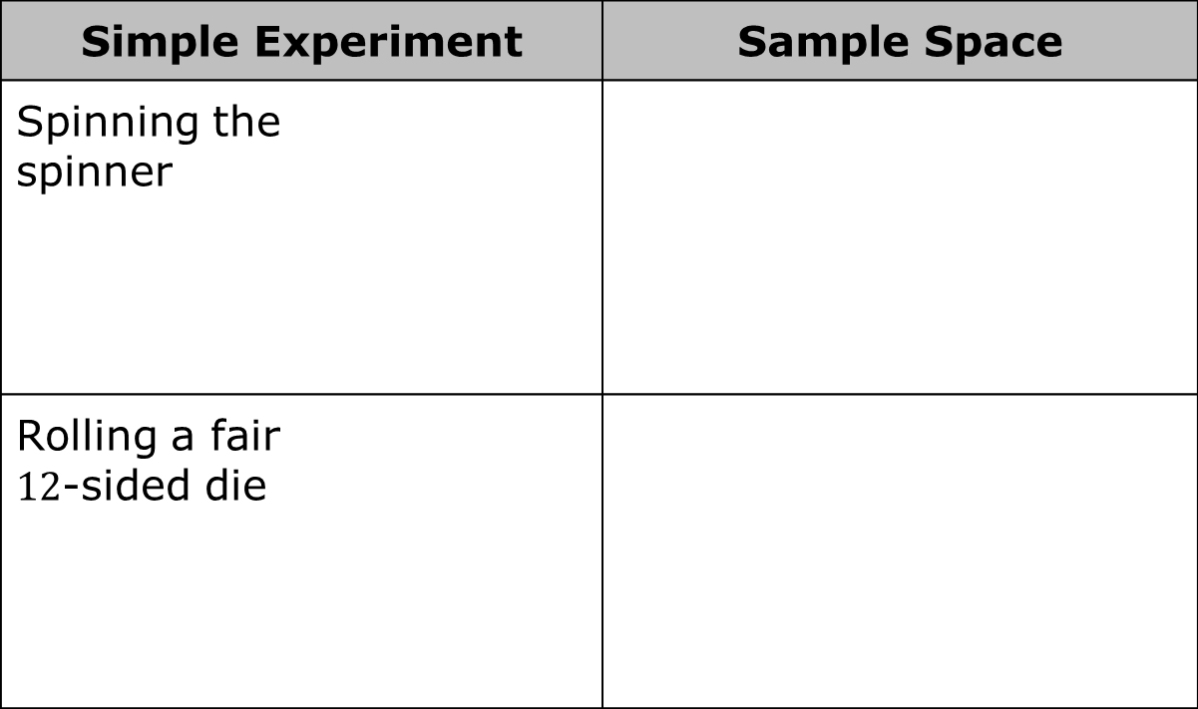
15.2.4 Guided Practice: Determining Sample Space of Simple Experiments
For each simple experiment in the table, determine the sample space.
Simple Experiment | Sample Space
Spinning the spinner
Rolling a fair $12$-sided die
volume 2, pg. 409

Slide 20
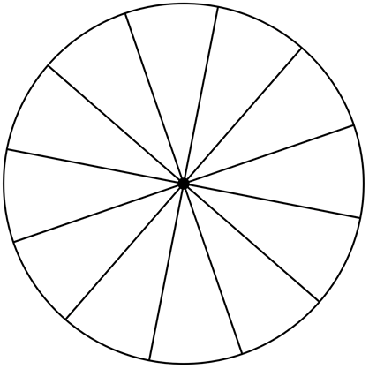
Complete the following.
Given the sample space of {Reese’s, Snickers, Twix, Kit Kat}, label the game wheel so that there is a fair chance of winning each candy bar as a prize.
Explain how you determined the labels for the game board.
volume 2, pg. 410

Slide 21

Wrap-Up
volume 2, pg. 410

Slide 22
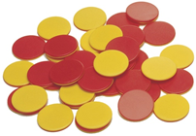
15.2.5 Wrap-Up: Ticket Out the Door
For each simple experiment in the table, determine the sample space.
Simple Experiment | Sample Space
Selecting a day of the week from a deck of cards with each day written on one card
Flipping an integer chip
volume 2, pg. 410

